Slide 1
(?i)reg(ular expressions?|ex(p|es)?)

Slide 2
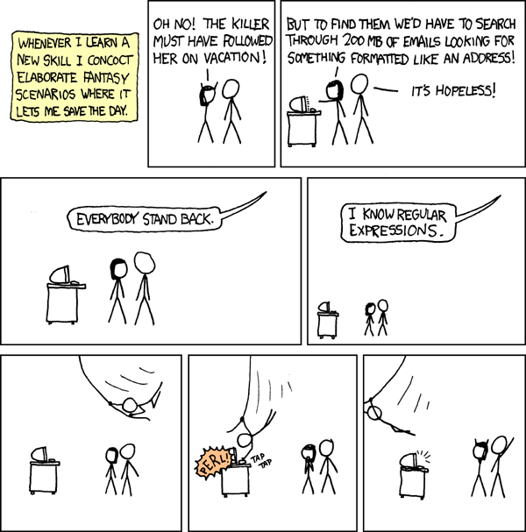

Slide 3
Regex can be a pain
“Some people, when confronted with a problem, think "I know, I'll use regular expressions." Now they have two problems.”
- Jamie Zawinski
But…

Slide 4
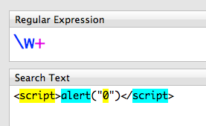
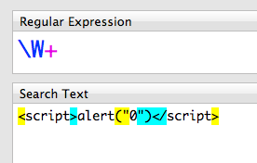
Regex is amazing
How do you validate an email?
\b[A-Z0-9._%+-]+@[A-Z0-9.-]+\.[A-Z]{2,4}\b
How can you sanitize user input?
Only allow what matches: \w+
Strip what matches: \W+

Slide 5
Regex (Regular Expressions)
A sequence of characters that form a search pattern, mainly used for pattern matching strings
Every character in a regular expression is either a metacharacter with a special meaning or a regular character with a literal meaning
Concept arose in the 1950s when American mathematician Stephen Kleene formalized the description of a “regular language”

Slide 6
Basic concepts
A regular expression (pattern) is an expression used to specify a set of strings
Common operations used in construction:
Boolean “or”
A | to separate alternatives. grey|gray matches both grey and gray
Grouping
A () can be used to limit the scope of an operator.
gr(a|e)y matches gray and grey because () limits scope of |
Quantification
Specifies how often the preceding element is allowed to occur.
Common quantifiers are: ? (0|1) * (0|+) + (1+)
colou?r matches color and colour
ab*c matches ac, abc, abbc, abbbc, etc.
ab+c matches abc, abbc, abbbc, etc. but not ac

Slide 7
Example
Match:
informatics
Information
Match:
Handel
Haendel
Händel

Slide 8
Answer
informati(cs|on)
What about:
inFoRmation
(?i)informati(cs|on)
H(ä|ae?)ndel

Slide 9
More syntax
.
Matches any single character
[ ]
Matches a single character or range of characters within the brackets
[^ ]
Matches a single character that is not contained within the brackets
^
Matches the starting position within the string
$
Matches the ending position of the string
( )
Defines a marked subexpression. The string matched can be recalled later with \n (n = 0+)
\n
Matches the nth marked subexpression matched where 9 is a digit from 1-9
{m,n}
Matches the preceding element at least m and not more than n times

Slide 10
More examples
.at
Matches any three-character string ending with “at”, including “hat”, “cat”, and “bat”
[hc]at
Matches “hat” and “cat”
[^b]at
Matches all strings matched by .at except “bat”
[^hc]at
Matches all strings matched by .at other than “hat” and “cat”
^[hc]at
Matches “hat” and “cat”, but only at the beginning of the string or line
[hc]at$
Matches “hat” and “cat”, but only at the end of the string or line
\[.\]
Matches any single character surrounded by “[“ and “]” since brackets are escaped. Such as “[a]” and “[b]”
s.*
Matches any number of characters preceded by s, for example: “saw” and “seed”

Slide 11
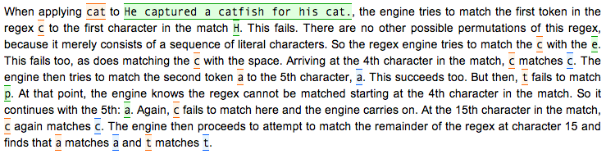
A shallow dip into how it works

Slide 12
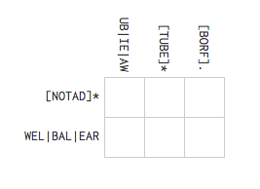
Practice

Slide 13
Useful in every day life
Proxy list cleanup example

Slide 14

Tools
https://www.debuggex.com/
Validating email addresses:
\b[A-Z0-9._%+-]+@[A-Z0-9.-]+\.[A-Z]{2,4}\b

Slide 15
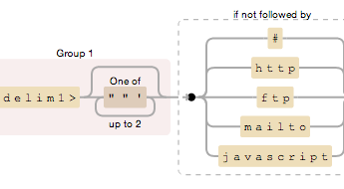
(<delim1>[""']{0,2})(?!#|http|ftp|mailto|javascript)

Slide 16
^(?:(?:(?:0?[13578]|1[02])(\/|-|\.)31)\1|(?:(?:0?[13-9]|1[0-2])(\/|-|\.)(?:29|30)\2))(?:(?:1[6-9]|[2-9]\d)?\d{2})$|^(?:0?2(\/|-|\.)29\3(?:(?:(?:1[6-9]|[2-9]\d)?(?:0[48]|[2468][048]|[13579][26])|(?:(?:16|[2468][048]|[3579][26])00))))$|^(?:(?:0?[1-9])|(?:1[0-2]))(\/|-|\.)(?:0?[1-9]|1\d|2[0-8])\4(?:(?:1[6-9]|[2-9]\d)?\d{2})$

Slide 17
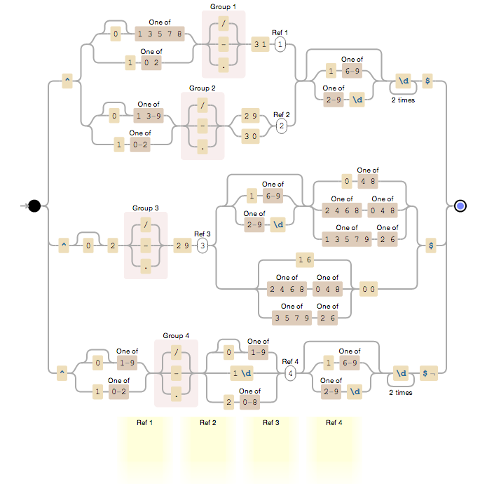

Slide 18
Try this one ☺
(?:(?:\r\n)?[ \t])*(?:(?:(?:[^()<>@,;:\\".\[\] \000-\031]+(?:(?:(?:\r\n)?[ \t])+|\Z|(?=[\["()<>@,;:\\".\[\]]))|"(?:[^\"\r\\]|\\.|(?:(?:\r\n)?[ \t]))*"(?:(?:\r\n)?[ \t])*)(?:\.(?:(?:\r\n)?[ \t])*(?:[^()<>@,;:\\".\[\] \000-\031]+(?:(?:(?:\r\n)?[ \t])+|\Z|(?=[\["()<>@,;:\\".\[\]]))|"(?:[^\"\r\\]|\\.|(?:(?:\r\n)?[ \t]))*"(?:(?:\r\n)?[ \t])*))*@(?:(?:\r\n)?[ \t])*(?:[^()<>@,;:\\".\[\] \000-\031]+(?:(?:(?:\r\n)?[ \t])+|\Z|(?=[\["()<>@,;:\\".\[\]]))|\[([^\[\]\r\\]|\\.)*\](?:(?:\r\n)?[ \t])*)(?:\.(?:(?:\r\n)?[ \t])*(?:[^()<>@,;:\\".\[\] \000-\031]+(?:(?:(?:\r\n)?[ \t])+|\Z|(?=[\["()<>@,;:\\".\[\]]))|\[([^\[\]\r\\]|\\.)*\](?:(?:\r\n)?[ \t])*))*|(?:[^()<>@,;:\\".\[\] \000-\031]+(?:(?:(?:\r\n)?[ \t])+|\Z|(?=[\["()<>@,;:\\".\[\]]))|"(?:[^\"\r\\]|\\.|(?:(?:\r\n)?[ \t]))*"(?:(?:\r\n)?[ \t])*)*\<(?:(?:\r\n)?[ \t])*(?:@(?:[^()<>@,;:\\".\[\] \000-\031]+(?:(?:(?:\r\n)?[ \t])+|\Z|(?=[\["()<>@,;:\\".\[\]]))|\[([^\[\]\r\\]|\\.)*\](?:(?:\r\n)?[ \t])*)(?:\.(?:(?:\r\n)?[ \t])*(?:[^()<>@,;:\\".\[\] \000-\031]+(?:(?:(?:\r\n)?[ \t])+|\Z|(?=[\["()<>@,;:\\".\[\]]))|\[([^\[\]\r\\]|\\.)*\](?:(?:\r\n)?[ \t])*))*(?:,@(?:(?:\r\n)?[ \t])*(?:[^()<>@,;:\\".\[\] \000-\031]+(?:(?:(?:\r\n)?[ \t])+|\Z|(?=[\["()<>@,;:\\".\[\]]))|\[([^\[\]\r\\]|\\.)*\](?:(?:\r\n)?[ \t])*)(?:\.(?:(?:\r\n)?[ \t])*(?:[^()<>@,;:\\".\[\] \000-\031]+(?:(?:(?:\r\n)?[ \t])+|\Z|(?=[\["()<>@,;:\\".\[\]]))|\[([^\[\]\r\\]|\\.)*\](?:(?:\r\n)?[ \t])*))*)*:(?:(?:\r\n)?[ \t])*)?(?:[^()<>@,;:\\".\[\] \000-\031]+(?:(?:(?:\r\n)?[ \t])+|\Z|(?=[\["()<>@,;:\\".\[\]]))|"(?:[^\"\r\\]|\\.|(?:(?:\r\n)?[ \t]))*"(?:(?:\r\n)?[ \t])*)(?:\.(?:(?:\r\n)?[ \t])*(?:[^()<>@,;:\\".\[\] \000-\031]+(?:(?:(?:\r\n)?[ \t])+|\Z|(?=[\["()<>@,;:\\".\[\]]))|"(?:[^\"\r\\]|\\.|(?:(?:\r\n)?[ \t]))*"(?:(?:\r\n)?[ \t])*))*@(?:(?:\r\n)?[ \t])*(?:[^()<>@,;:\\".\[\] \000-\031]+(?:(?:(?:\r\n)?[ \t])+|\Z|(?=[\["()<>@,;:\\".\[\]]))|\[([^\[\]\r\\]|\\.)*\](?:(?:\r\n)?[ \t])*)(?:\.(?:(?:\r\n)?[ \t])*(?:[^()<>@,;:\\".\[\] \000-\031]+(?:(?:(?:\r\n)?[ \t])+|\Z|(?=[\["()<>@,;:\\".\[\]]))|\[([^\[\]\r\\]|\\.)*\](?:(?:\r\n)?[ \t])*))*\>(?:(?:\r\n)?[ \t])*)|(?:[^()<>@,;:\\".\[\] \000-\031]+(?:(?:(?:\r\n)?[ \t])+|\Z|(?=[\["()<>@,;:\\".\[\]]))|"(?:[^\"\r\\]|\\.|(?:(?:\r\n)?[ \t]))*"(?:(?:\r\n)?[ \t])*)*:(?:(?:\r\n)?[ \t])*(?:(?:(?:[^()<>@,;:\\".\[\] \000-\031]+(?:(?:(?:\r\n)?[ \t])+|\Z|(?=[\["()<>@,;:\\".\[\]]))|"(?:[^\"\r\\]|\\.|(?:(?:\r\n)?[ \t]))*"(?:(?:\r\n)?[ \t])*)(?:\.(?:(?:\r\n)?[ \t])*(?:[^()<>@,;:\\".\[\] \000-\031]+(?:(?:(?:\r\n)?[ \t])+|\Z|(?=[\["()<>@,;:\\".\[\]]))|"(?:[^\"\r\\]|\\.|(?:(?:\r\n)?[ \t]))*"(?:(?:\r\n)?[ \t])*))*@(?:(?:\r\n)?[ \t])*(?:[^()<>@,;:\\".\[\] \000-\031]+(?:(?:(?:\r\n)?[ \t])+|\Z|(?=[\["()<>@,;:\\".\[\]]))|\[([^\[\]\r\\]|\\.)*\](?:(?:\r\n)?[ \t])*)(?:\.(?:(?:\r\n)?[ \t])*(?:[^()<>@,;:\\".\[\] \000-\031]+(?:(?:(?:\r\n)?[ \t])+|\Z|(?=[\["()<>@,;:\\".\[\]]))|\[([^\[\]\r\\]|\\.)*\](?:(?:\r\n)?[ \t])*))*|(?:[^()<>@,;:\\".\[\] \000-\031]+(?:(?:(?:\r\n)?[ \t])+|\Z|(?=[\["()<>@,;:\\".\[\]]))|"(?:[^\"\r\\]|\\.|(?:(?:\r\n)?[ \t]))*"(?:(?:\r\n)?[ \t])*)*\<(?:(?:\r\n)?[ \t])*(?:@(?:[^()<>@,;:\\".\[\] \000-\031]+(?:(?:(?:\r\n)?[ \t])+|\Z|(?=[\["()<>@,;:\\".\[\]]))|\[([^\[\]\r\\]|\\.)*\](?:(?:\r\n)?[ \t])*)(?:\.(?:(?:\r\n)?[ \t])*(?:[^()<>@,;:\\".\[\] \000-\031]+(?:(?:(?:\r\n)?[ \t])+|\Z|(?=[\["()<>@,;:\\".\[\]]))|\[([^\[\]\r\\]|\\.)*\](?:(?:\r\n)?[ \t])*))*(?:,@(?:(?:\r\n)?[ \t])*(?:[^()<>@,;:\\".\[\] \000-\031]+(?:(?:(?:\r\n)?[ \t])+|\Z|(?=[\["()<>@,;:\\".\[\]]))|\[([^\[\]\r\\]|\\.)*\](?:(?:\r\n)?[ \t])*)(?:\.(?:(?:\r\n)?[ \t])*(?:[^()<>@,;:\\".\[\] \000-\031]+(?:(?:(?:\r\n)?[ \t])+|\Z|(?=[\["()<>@,;:\\".\[\]]))|\[([^\[\]\r\\]|\\.)*\](?:(?:\r\n)?[ \t])*))*)*:(?:(?:\r\n)?[ \t])*)?(?:[^()<>@,;:\\".\[\] \000-\031]+(?:(?:(?:\r\n)?[ \t])+|\Z|(?=[\["()<>@,;:\\".\[\]]))|"(?:[^\"\r\\]|\\.|(?:(?:\r\n)?[ \t]))*"(?:(?:\r\n)?[ \t])*)(?:\.(?:(?:\r\n)?[ \t])*(?:[^()<>@,;:\\".\[\] \000-\031]+(?:(?:(?:\r\n)?[ \t])+|\Z|(?=[\["()<>@,;:\\".\[\]]))|"(?:[^\"\r\\]|\\.|(?:(?:\r\n)?[ \t]))*"(?:(?:\r\n)?[ \t])*))*@(?:(?:\r\n)?[ \t])*(?:[^()<>@,;:\\".\[\] \000-\031]+(?:(?:(?:\r\n)?[ \t])+|\Z|(?=[\["()<>@,;:\\".\[\]]))|\[([^\[\]\r\\]|\\.)*\](?:(?:\r\n)?[ \t])*)(?:\.(?:(?:\r\n)?[ \t])*(?:[^()<>@,;:\\".\[\] \000-\031]+(?:(?:(?:\r\n)?[ \t])+|\Z|(?=[\["()<>@,;:\\".\[\]]))|\[([^\[\]\r\\]|\\.)*\](?:(?:\r\n)?[ \t])*))*\>(?:(?:\r\n)?[ \t])*)(?:,\s*(?:(?:[^()<>@,;:\\".\[\] \000-\031]+(?:(?:(?:\r\n)?[ \t])+|\Z|(?=[\["()<>@,;:\\".\[\]]))|"(?:[^\"\r\\]|\\.|(?:(?:\r\n)?[ \t]))*"(?:(?:\r\n)?[ \t])*)(?:\.(?:(?:\r\n)?[ \t])*(?:[^()<>@,;:\\".\[\] \000-\031]+(?:(?:(?:\r\n)?[ \t])+|\Z|(?=[\["()<>@,;:\\".\[\]]))|"(?:[^\"\r\\]|\\.|(?:(?:\r\n)?[ \t]))*"(?:(?:\r\n)?[ \t])*))*@(?:(?:\r\n)?[ \t])*(?:[^()<>@,;:\\".\[\] \000-\031]+(?:(?:(?:\r\n)?[ \t])+|\Z|(?=[\["()<>@,;:\\".\[\]]))|\[([^\[\]\r\\]|\\.)*\](?:(?:\r\n)?[ \t])*)(?:\.(?:(?:\r\n)?[ \t])*(?:[^()<>@,;:\\".\[\] \000-\031]+(?:(?:(?:\r\n)?[ \t])+|\Z|(?=[\["()<>@,;:\\".\[\]]))|\[([^\[\]\r\\]|\\.)*\](?:(?:\r\n)?[ \t])*))*|(?:[^()<>@,;:\\".\[\] \000-\031]+(?:(?:(?:\r\n)?[ \t])+|\Z|(?=[\["()<>@,;:\\".\[\]]))|"(?:[^\"\r\\]|\\.|(?:(?:\r\n)?[ \t]))*"(?:(?:\r\n)?[ \t])*)*\<(?:(?:\r\n)?[ \t])*(?:@(?:[^()<>@,;:\\".\[\] \000-\031]+(?:(?:(?:\r\n)?[ \t])+|\Z|(?=[\["()<>@,;:\\".\[\]]))|\[([^\[\]\r\\]|\\.)*\](?:(?:\r\n)?[ \t])*)(?:\.(?:(?:\r\n)?[ \t])*(?:[^()<>@,;:\\".\[\] \000-\031]+(?:(?:(?:\r\n)?[ \t])+|\Z|(?=[\["()<>@,;:\\".\[\]]))|\[([^\[\]\r\\]|\\.)*\](?:(?:\r\n)?[ \t])*))*(?:,@(?:(?:\r\n)?[ \t])*(?:[^()<>@,;:\\".\[\] \000-\031]+(?:(?:(?:\r\n)?[ \t])+|\Z|(?=[\["()<>@,;:\\".\[\]]))|\[([^\[\]\r\\]|\\.)*\](?:(?:\r\n)?[ \t])*)(?:\.(?:(?:\r\n)?[ \t])*(?:[^()<>@,;:\\".\[\] \000-\031]+(?:(?:(?:\r\n)?[ \t])+|\Z|(?=[\["()<>@,;:\\".\[\]]))|\[([^\[\]\r\\]|\\.)*\](?:(?:\r\n)?[ \t])*))*)*:(?:(?:\r\n)?[ \t])*)?(?:[^()<>@,;:\\".\[\] \000-\031]+(?:(?:(?:\r\n)?[ \t])+|\Z|(?=[\["()<>@,;:\\".\[\]]))|"(?:[^\"\r\\]|\\.|(?:(?:\r\n)?[ \t]))*"(?:(?:\r\n)?[ \t])*)(?:\.(?:(?:\r\n)?[ \t])*(?:[^()<>@,;:\\".\[\] \000-\031]+(?:(?:(?:\r\n)?[ \t])+|\Z|(?=[\["()<>@,;:\\".\[\]]))|"(?:[^\"\r\\]|\\.|(?:(?:\r\n)?[ \t]))*"(?:(?:\r\n)?[ \t])*))*@(?:(?:\r\n)?[ \t])*(?:[^()<>@,;:\\".\[\] \000-\031]+(?:(?:(?:\r\n)?[ \t])+|\Z|(?=[\["()<>@,;:\\".\[\]]))|\[([^\[\]\r\\]|\\.)*\](?:(?:\r\n)?[ \t])*)(?:\.(?:(?:\r\n)?[ \t])*(?:[^()<>@,;:\\".\[\] \000-\031]+(?:(?:(?:\r\n)?[ \t])+|\Z|(?=[\["()<>@,;:\\".\[\]]))|\[([^\[\]\r\\]|\\.)*\](?:(?:\r\n)?[ \t])*))*\>(?:(?:\r\n)?[ \t])*))*)?;\s*)

Slide 19
Regex crossword
Give it a shot: http://regexcrossword.com/

Slide 20
Learn more
http://regex.learncodethehardway.org/book/
http://nbviewer.ipython.org/url/norvig.com/ipython/xkcd1313-part2.ipynb?create=1

Slide 21
References
https://en.wikipedia.org/wiki/Regular_expression
https://programmers.stackexchange.com/questions/122440/how-do-regular-expressions-actually-work
https://stackoverflow.com/questions/3622398/how-a-regex-engine-works
http://www.regular-expressions.info/engine.html
http://www.regular-expressions.info/tutorial.html

